Slide 1

Wine Quality Prediction
LIU WENJUAN ​

Slide 2
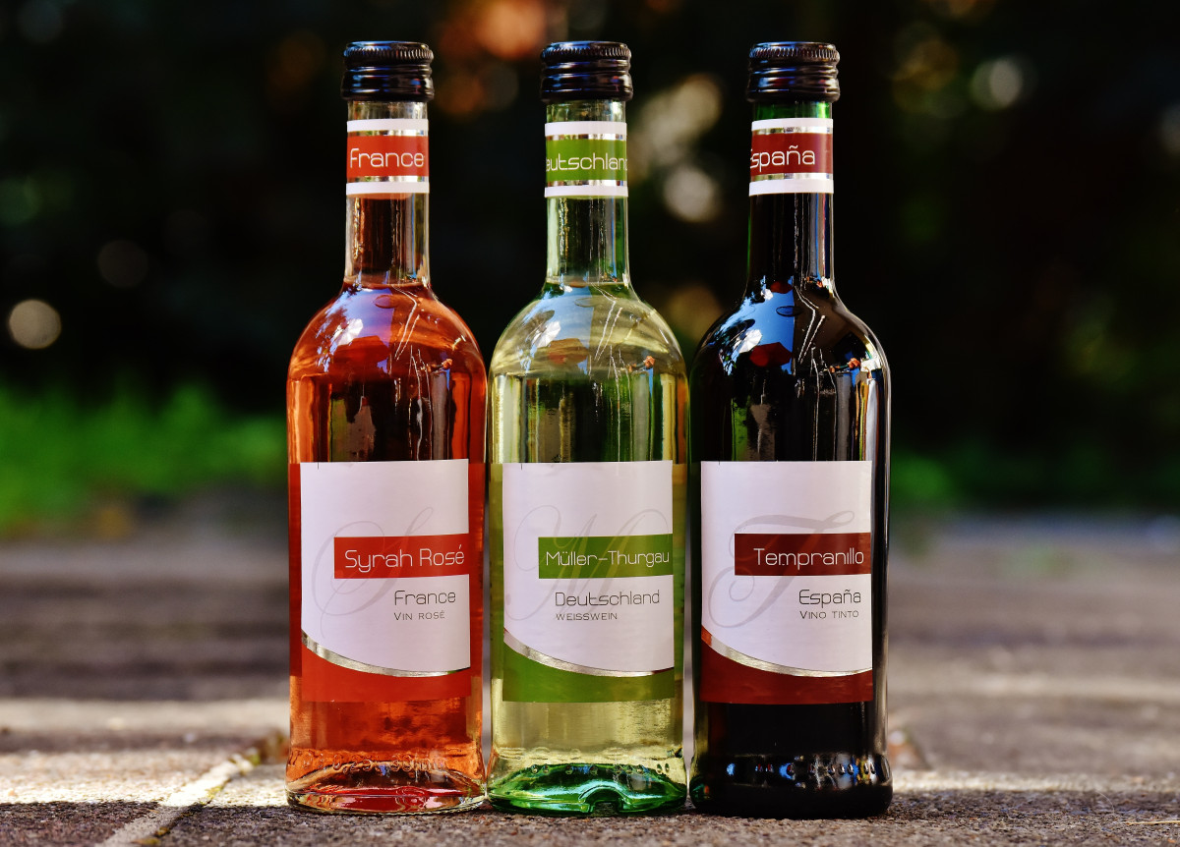
Agenda
Introduction
Primary goals
DATA ANALYSIS
Summary

Slide 3

Introduction
The wine quality dataset we have at our disposal is a treasure trove of chemical and sensory attributes gathered from various wine samples. It offers valuable insights into the contributing factors that influence the quality of wines. These factors include acidity levels, residual sugar, sulfur dioxide content, and many more.

Slide 4
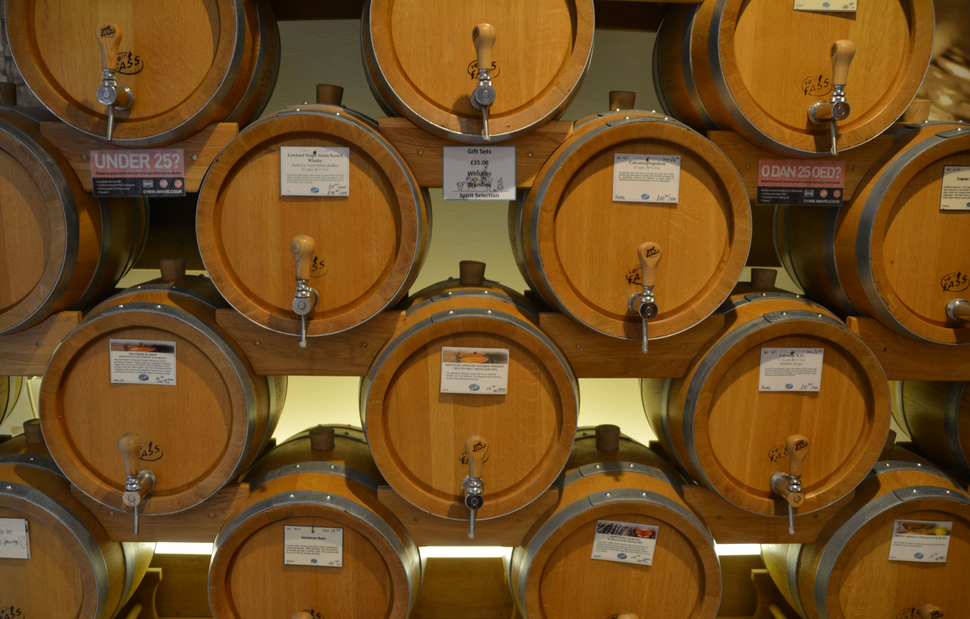
Problem statement
The challenge at hand is to determine whether the quality of the wine is considered good or not, and furthermore, to quantify how good the quality is. This requires us to analyze and extract meaningful insights from the dataset, which includes various chemical attributes contributing to the wine's overall quality.

Slide 5

Primary goals
first, to perform an in-depth Exploratory Data Analysis (EDA) to understand the relationships between different features and wine quality ratings.
Second, we aim to develop a robust predictive model that can accurately estimate wine quality, enabling stakeholders to make informed decisions in the wine production process.

Slide 6
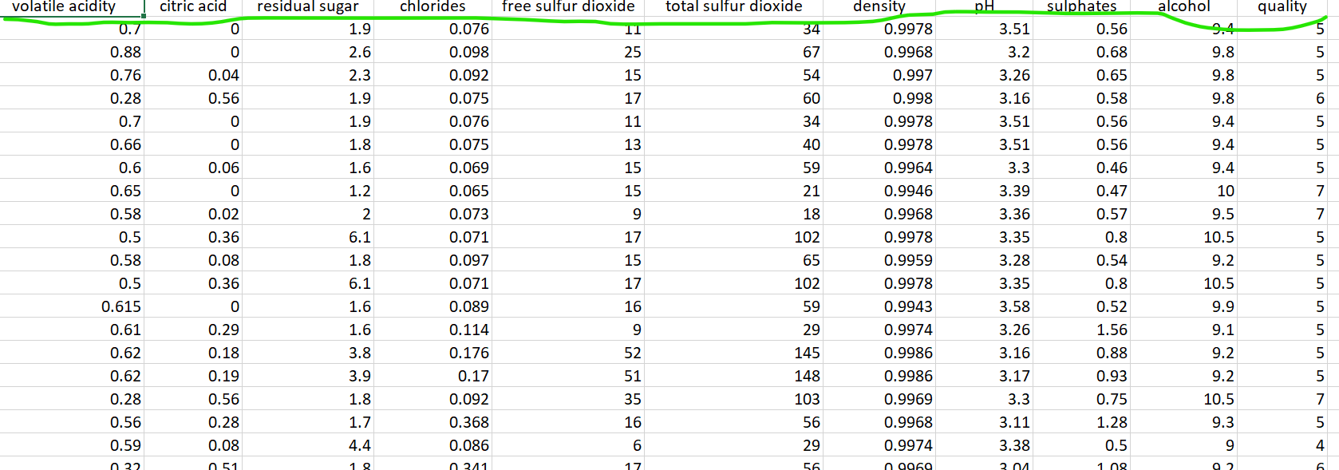
Dataset review

Slide 7
dataset’ source
https://www.kaggle.com/datasets/uciml/red-wine-quality-cortez-et-al-2009
This dataset includes variables: fixed acidity, volatile acidity, citric acid, residual sugar, chlorides, free sulfur dioxide, total sulfur dioxide, density, PH, sulphates, alcohol. Output variable is quality.

Slide 8
Work flow
Wine data
Data Analysis
Data Pre processing
Train Test split
Random forest model
Prediction
New Data

Slide 9
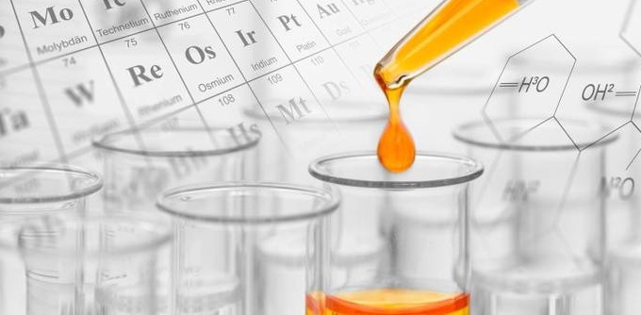
“Business opportunities are like buses. There’s always another one coming.”
Richard Branson

Slide 10

Summary
In this project, we performed an in-depth Exploratory Data Analysis (EDA) on the wine dataset to understand the relationships between different features and wine quality ratings. Subsequently, we developed a robust predictive model using the Random Forest Classifier, which demonstrated the highest accuracy in estimating wine quality. This predictive model can now be used to make informed decisions in the wine production process by accurately predicting wine quality ratings for new data.

Slide 11

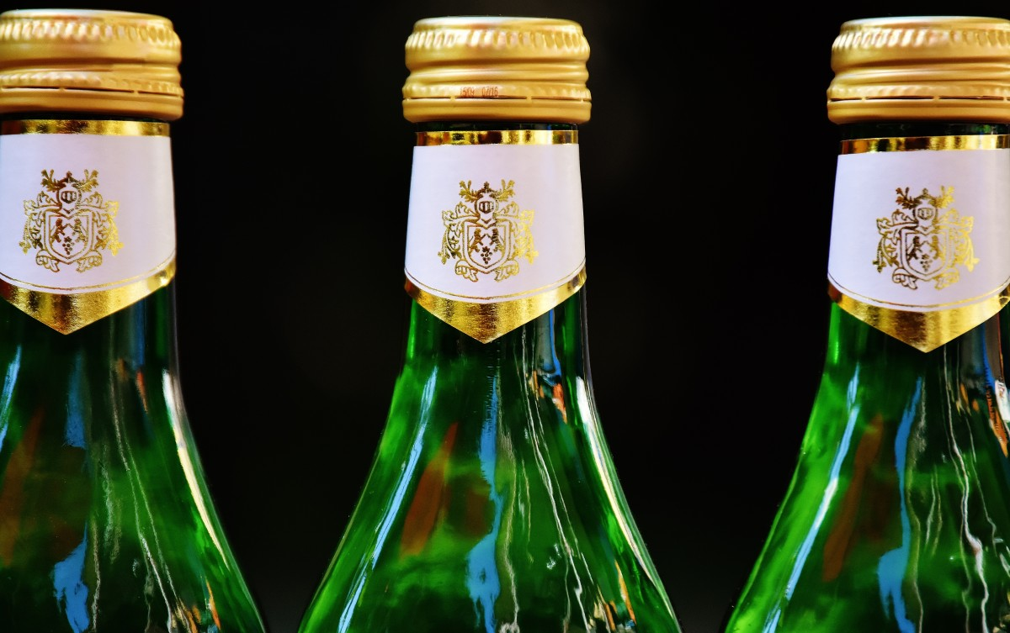
Thank you
LIU WENJUAN
Wenjuan.liu@student.sl.on.ca

